Slide 1
EMAIL Verification System

Slide 2
Working Process
Email ID as user Input
Using HTML form post take an email ID as user input and validate the email user info regular expression.
- Domain Name of the Email ID
Retriveing Domain Name (FQDN) of the provided Email ID using regular expression.
- MX Record of Domain Name MX Record of the Domain Name (FQDN) is fetched by making DNS Query.
MX is the email server specified in the DNS record. A domain name could have more than one MX record and one is selected in random order.
- Socket connection and SMTP commands
Open a socket connection on port 25 with the MX Record Domain and Send SMPT commands in sequence to verify the Input Email Address.
If any command fails, it concludes that the email address is invalid. If SMTP server gives success response code 250 for all commands then the email address is a valid email address

Slide 3
FQDN
A fully qualified domain name (FQDN), sometimes also referred to as an absolute domain name, is a domain name that specifies its exact location in the tree hierarchy of the Domain Name System (DNS). It specifies all domain levels, including the top-level domain and the root zone.
An FQDN serves as the unique pathway of a specific webpage in the same way that each folder and file on a user’s computer has a unique pathway. While a user’s computer uses “C:/”, “D:/”, or another letter to designate the hard drive that the folder or file is located on, an FQDN uses “.com”, “.net”, or another abbreviation to designate the domain that a webserver is hosted on.
Similarly, a computer may use “Windows”, “Programs”, or another name to designate folders on the hard drive, while FQDNs use “.tech-faq”, “.wikipedia”, or another name to designate the webserver or “folder” that is located on the domain.Likewise, each webserver is allowed to create subdomains, such as “myemail”, “blog”, “news”, or simply “www” to designate specific folders within a webserver. All files on a webserver are then listed after the “.com” or “.net” extension to specify the exact location of a webpage.
For example, http://www.tech-faq.com/fqdn.html is used to describe the exact location of this webpage, in which this HTML document is located in the “www” folder of the Tech-FAQ server on the “.com” domain and your browser is using HTTP to access

Slide 4
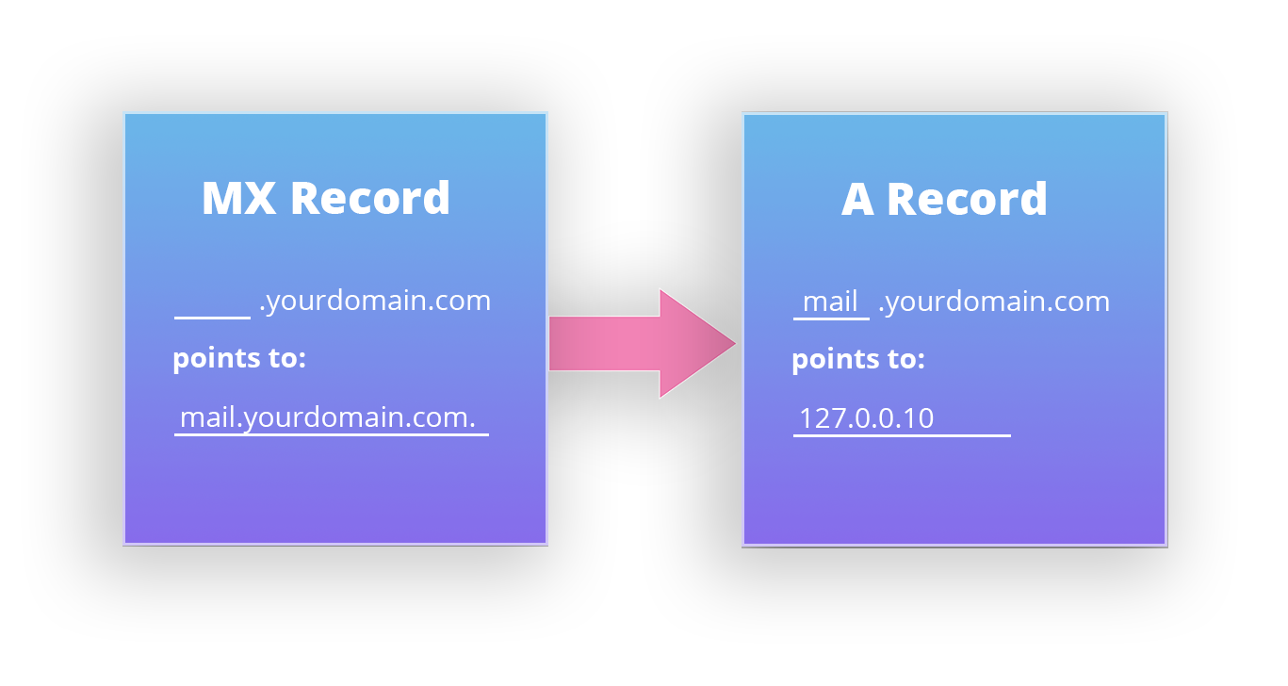
MX Record
MX, or Mail Exchange, records are used by mail servers to determine where to deliver email. MX, or Mail Exchange, records are used by mail servers to determine where to deliver email.

Slide 5
MX Record
MX records must be used in conjunction with A records. The A record will point to the mail server(s). When another mail server wants to communicate with your mail server, it will look for an MX record. That MX record must point to the A record which points to the mail server’s IP address.
If an MX record is missing for the domain, then the mail for the domain will normally be attempted to be delivered to the matching A record. So for the domain “yourdomain.com” if there were no MX records for “yourdomain.com” then the mail would be attempted to delivered to the apex/root record of “yourdomain.com”.

Slide 6
SMTP
SMTP(Simple Mail Transfer Protocol) is a push protocol and is used to send the mail whereas POP (post office protocol) or IMAP (internet message access protocol) are used to retrieve those mails at the receiver’s side.
SMTP usually is implemented to operate over Internet port 25. An alternative to SMTP that is widely used in Europe is X.400. Many mail servers now support Extended Simple Mail Transfer Protocol (ESMTP), which allows multimedia files to be delivered as e-mail

Slide 7
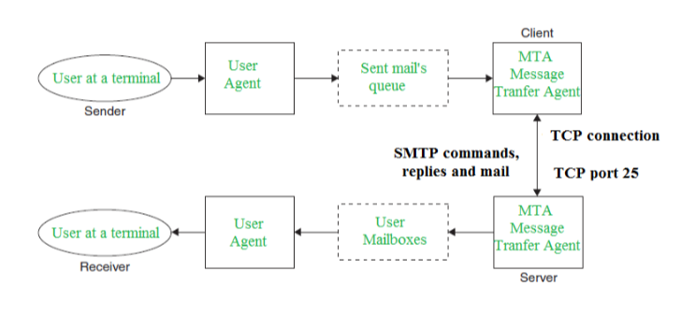
How SMTP works???

Slide 8
Message Transfer Agent (MTA)
A message transfer agent receives incoming emails and forwards the messages to individual clients/users. The main function of the MTA is forwarding the incoming message to the proper end-user or destination. Microsoft Exchange and UNIX sendmail are the best examples of MTAs.

Slide 9
Sending & Receiving Process
SENDING EMAIL:
Mail is sent by a series of request and response messages between the client and a server. The message which is sent across consists of a header and the body. A null line is used to terminate the mail header. Everything which is after the null line is considered as the body of the message which is a sequence of ASCII characters. The message body contains the actual information read by the receipt.
RECEIVING EMAIL:
The user agent at the server side checks the mailboxes at a particular time of intervals. If any information is received it informs the user about the mail. When the user tries to read the mail it displays a list of mails with a short description of each mail in the mailbox. By selecting any of the mail user can view its contents on the terminal.

Slide 10
Some SMTP Comments
•HELO – Identifies the client to the server, fully qualified domain name, only sent once per session
•MAIL – Initiate a message transfer, fully qualified domain of originator
•RCPT – Follows MAIL, identifies an addressee, typically the fully qualified name of the addressee and for multiple addressees use one RCPT for each addressee
•DATA – send data line by line

Slide 11
Example of SMTP Commands
> EHLO example.com >
MAIL FROM:<email@example.com>
> RCPT TO:<ashfinur@gmail.com>

Slide 12
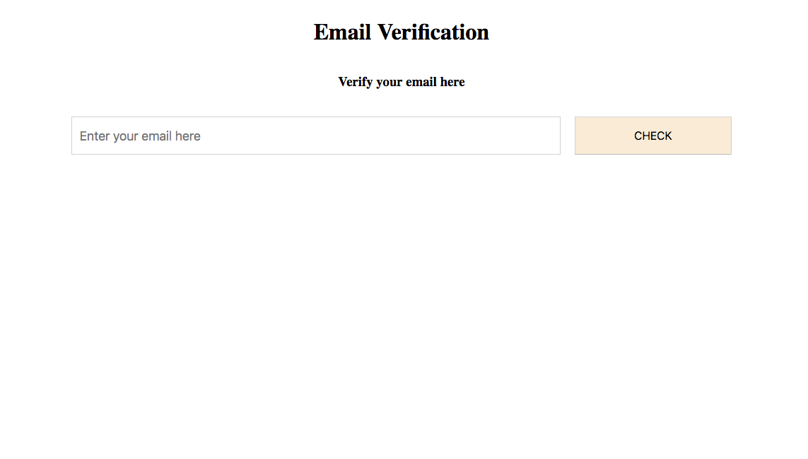
Result

Slide 13
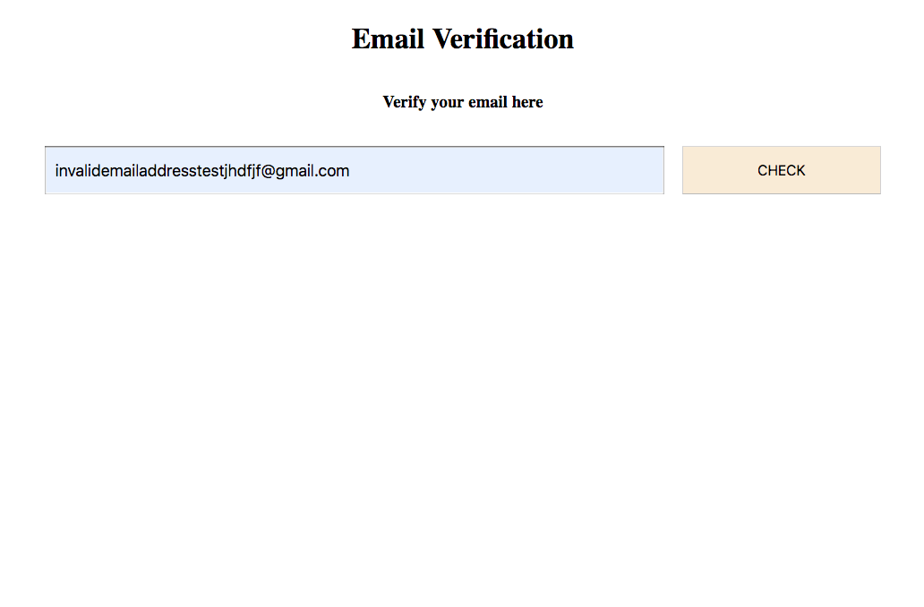
Result

Slide 14
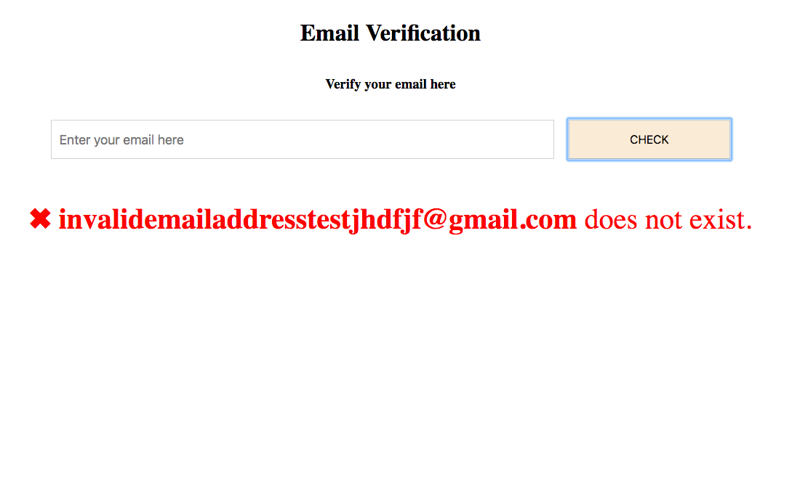
Result

Slide 15
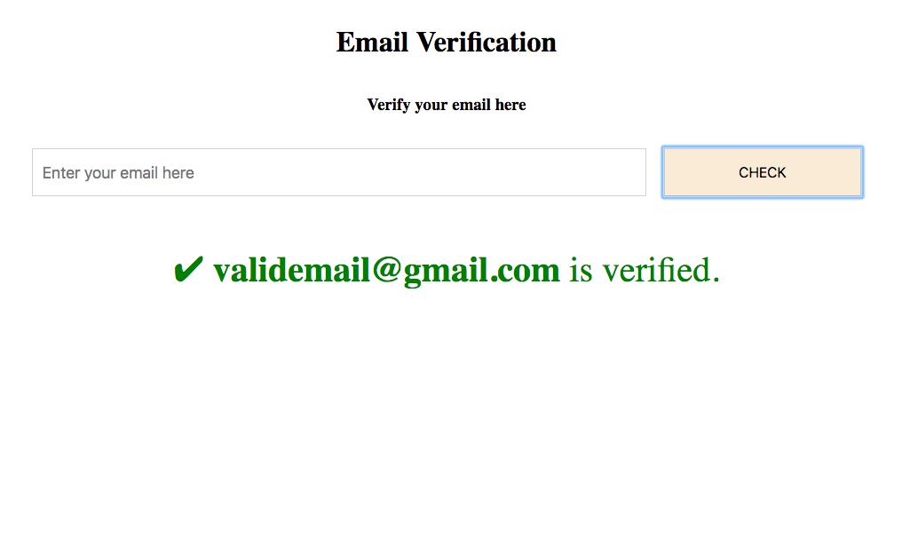
Result

